Slide 1


ANLY565 FINAL Project Tennis Ranking Forecast
Abhishek Singh
Arisara Kanaprasertkul
Rajkumar Dhanapal

Slide 2

Introduction & Motivation
The performance of tennis players was studied using data from the Association of Tennis Professionals (ATP) from 2010 to 2020
Top 3 players namely Roger Federer, Rafael Nadal, and Novak Djokovic were selected for this research
Goal of the project is to create a forecasting model to answer our research questions about player's future performance
Parallel goal is to apply skills acquired from the ANLY565 course on Time Series and Forecasting
Tennis has been a passion for the team members growing up. So, finding out who is going to perform best in the coming year is interesting. Similarly finding out different aspects of the game that can boost the performance of a given player.
Tennis data analysis can be a $100M industry. (Direct applications of the research not conceived though)

Slide 3

Hypothesis
Novak Djokovic is going to perform the best overall against Roger Federer and Rafael Nadal – this includes serving the most aces, winning the most matches, saving the most breakpoints.
Roger Federer is going to perform the best against Novak Djokovic and Rafael Nadal during July/August (around months of Wimbledon) as he is normally best at grass court – this includes serving the most aces, winning the most matches, saving the most breakpoints.
Rafael Nadal is going to perform the best against Novak Djokovic and Roger Federer during May/June (around months of French Open) as he is normally best at clay court – this includes serving the most aces, winning the most matches, saving the most breakpoints.

Slide 4
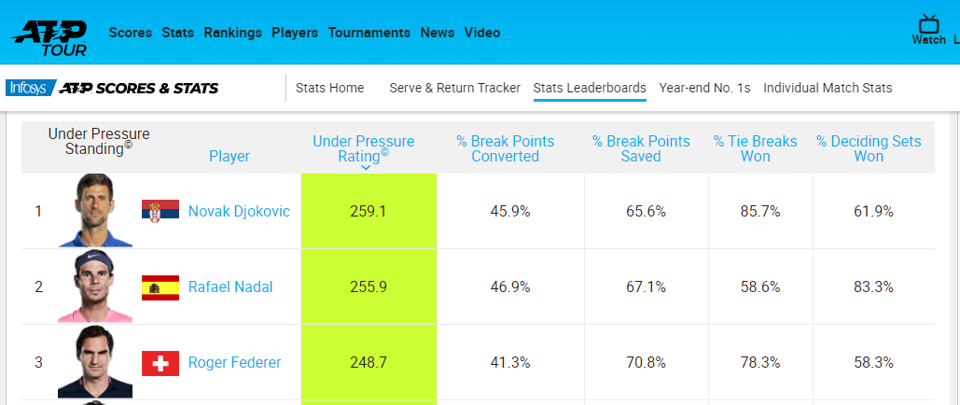
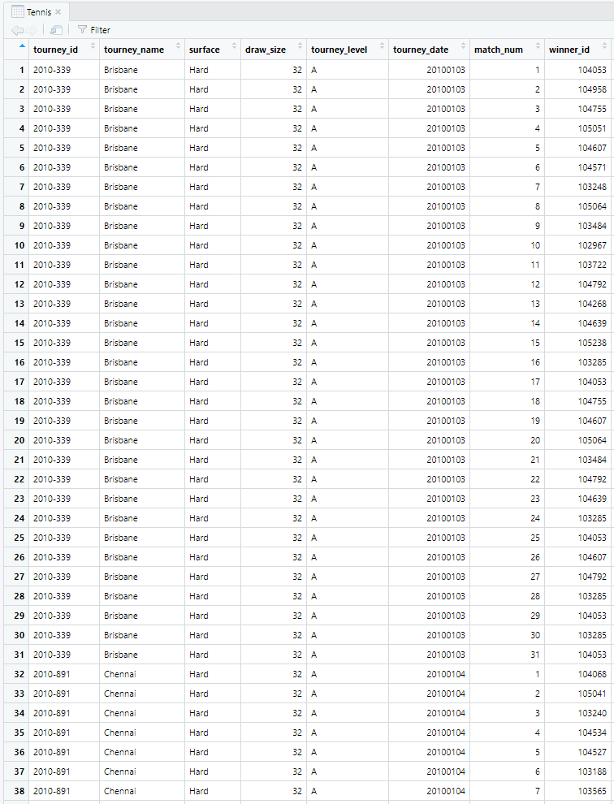
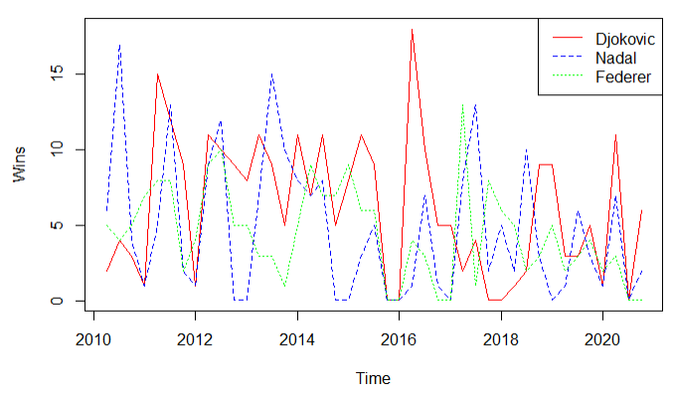

Data

Slide 5

Data
Original Source: Association of Tennis Professionals (ATP)
Pulled from: https://github.com/JeffSackmann/tennis_atp
Dimensions of original dataset: 30787 observations of 49 variables
Dimensions of analysis dataset: 132 obs. of 9 var & 43 obs. of 9 var
Time range of the timeseries data: Jan 2010 to Nov 2020

Slide 6
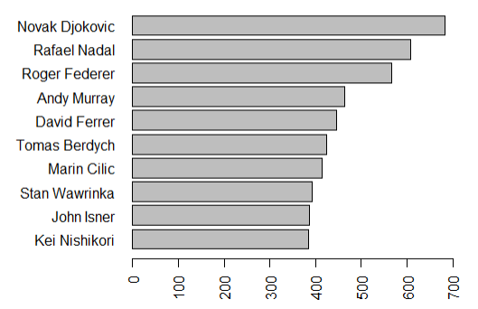
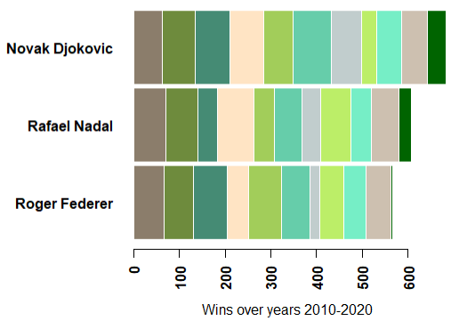

Data

Slide 7
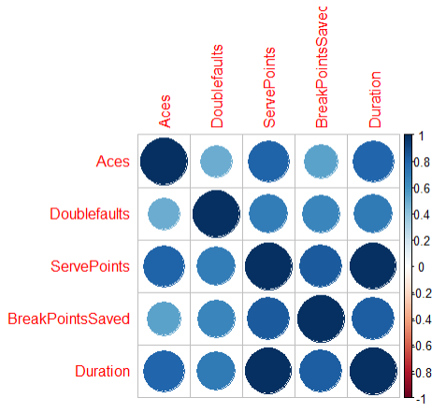
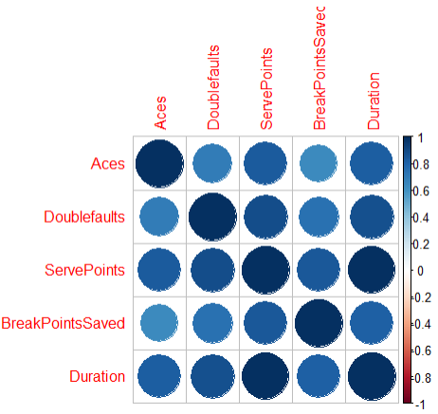
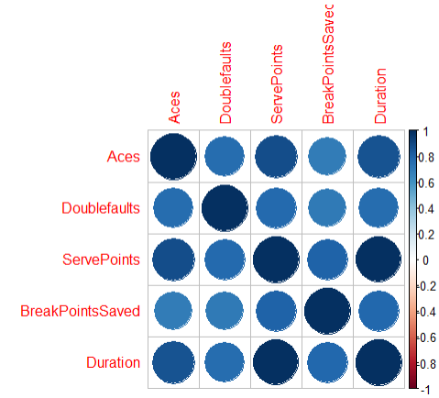
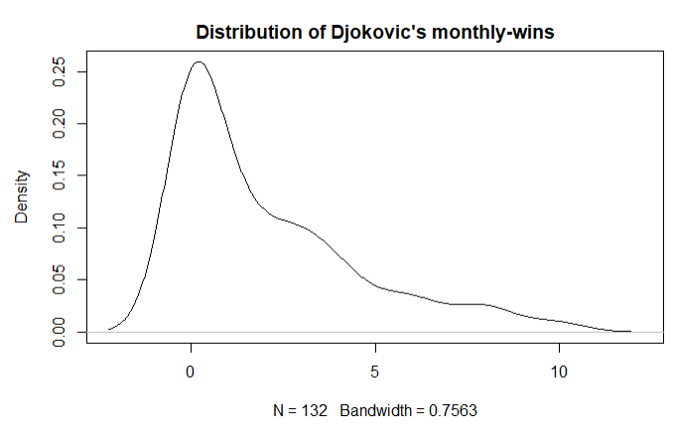
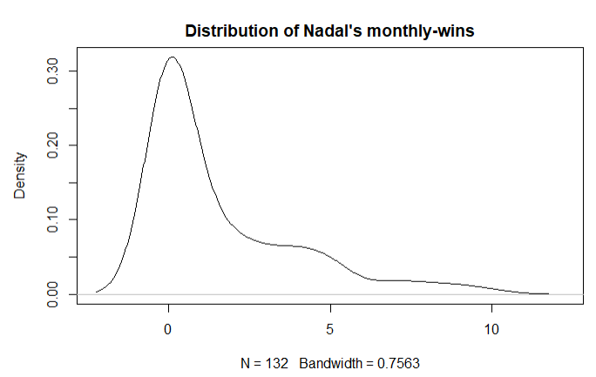
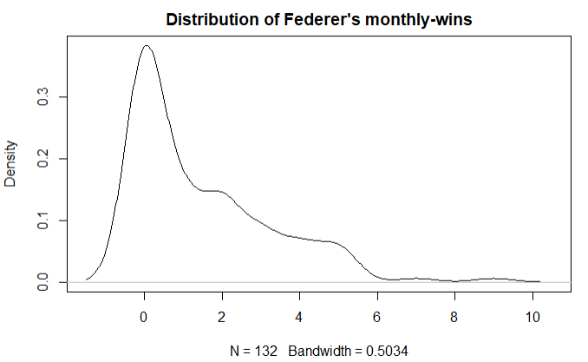

Data
Djokovic
Nadal
Federer
Correlation b/w performance Indices
Distribution of Wins

Slide 8

Methodology
Univariate models
(quarterly aggregated data)
Auto-regressive/ Moving Average models
Methodology
Multivariate models
(monthly aggregated data)
Linear Regression
Vector Auto Regression – VAR model
Exponential Smoothing models

Slide 9


Methodology – Multivariate Models
Our data was collected on more than one variable. There are multiple dependent and independent time series variables.
3 Variables to focus on: Aces, Breakpoints Saved, and Wins
Variables are stationary (Augmented Dickey-Fuller)
Variables are cointegrated (Phillips-Ouliaris Cointegration Tests)

Slide 10
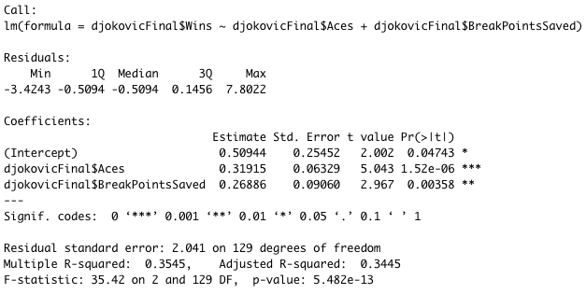
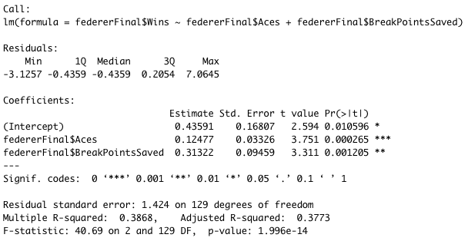
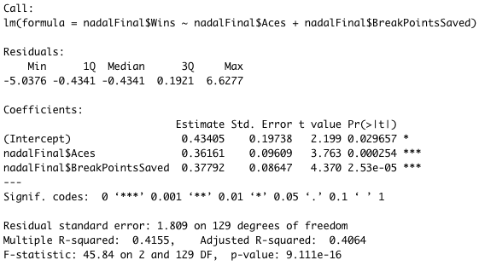

Methodology – Linear Regression
All models are statistically significant.
Results varied by player – better predictor/greater effect.
All ACFs show white noise, meaning the models are good to use.
Adjusted R-squared: 34-40% (not great).

Slide 11
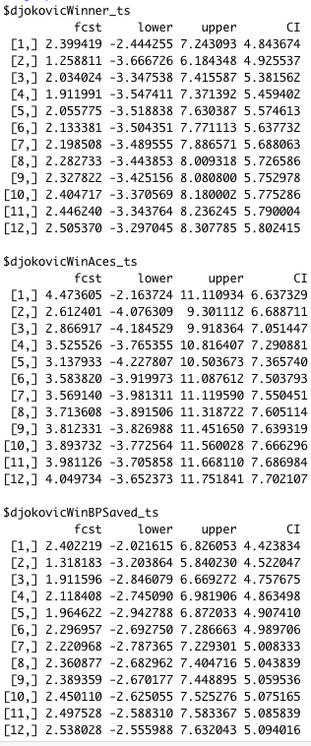
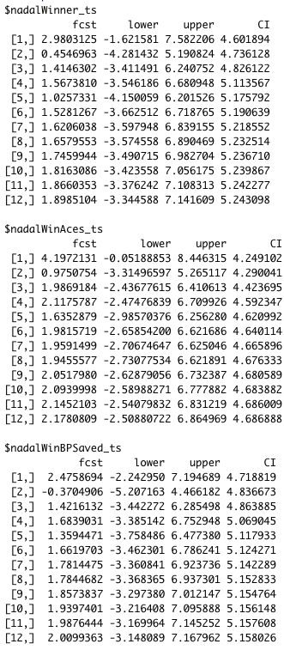
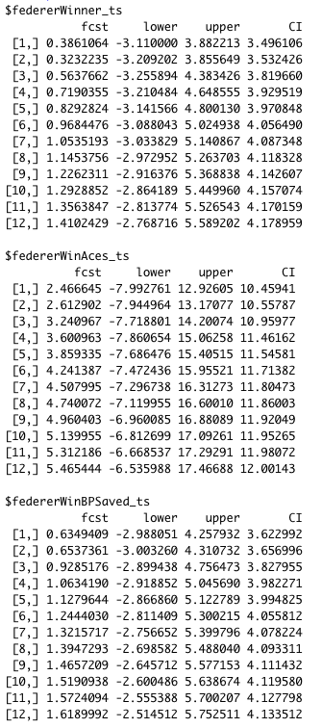

Methodology - VAR
Variables that made up the equations are stationary, containing no unit roots.
ACF graphs on the residual series all show white noise.
Therefore, VAR models are valid since all variables are stationary and exhibit no autocorrelation.
We then used these models to forecast the future values then analyze the results.

Slide 12
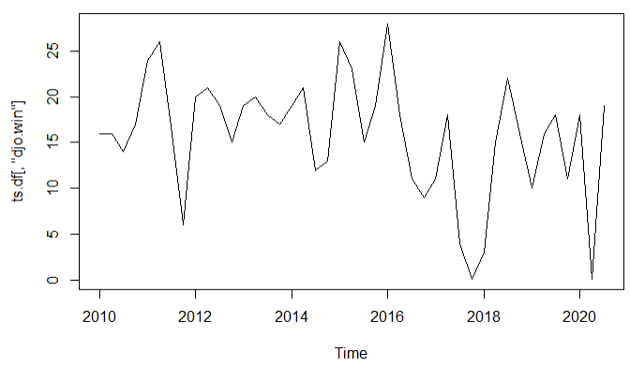
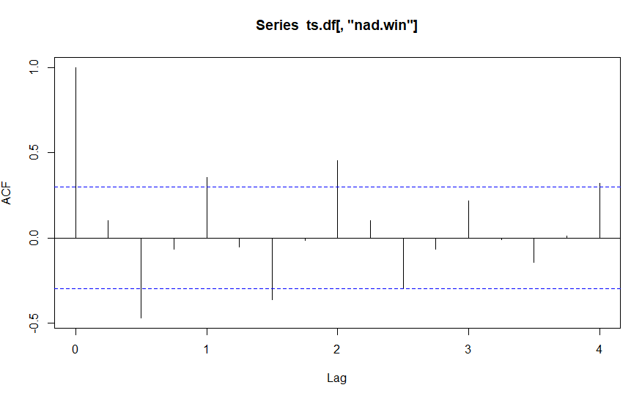
Methodology – Moving Average / Holtwinters
HoltWinters model
Moving Average model
Determine if the variable is stationary
Use Training dataset to determine Holtwinters coefficients and parameters to build the model
Predict values and evaluate against Test dataset
Predict future values for 2021
Examine ACF and PACF to determine auto-correlation
Iterate over Train dataset to find order of ARIMA with best AIC
Predict values and evaluate against Test dataset
Predict future values for 2021
Djokovic – Quarterly Wins
ACF
Notes:
We used quarterly aggregated data for these analyses. For both these models, we determine if the variable is stationary by analysing ACF signatures. Then using training dataset, we determine the best suited coefficients for the model. We evaluate the model against test dataset. If satisfactory, we use it to predict future values for 2021

Slide 13
Results - VAR
Djokovic is going to win more matches in general and perform better than the other two players overall. His highest winning months are towards the end of year (October to December).
Nadal comes in second place. His highest winning months are around beginning and end of year, with highest months being January, December, and November, respectively.
Federer will not perform as good as the other two. Interestingly, however, with predicted values of less wins, he is going to serve more aces of 50. He also seems to be doing best towards the end of year in October to December.
2021Yearly Predictions | Djokovic | Nadal | Federer
Wins | 26 | 20 | 11
Aces | 43 | 25 | 50
BP Saved | 26 | 20 | 15
Notes:
By using the VAR model, we were able to consider all the important performance metrics together, without worrying which one affects the other. As a whole we determined that Djokovic will have better performance throughout 2021 compared to the 2 other players

Slide 14
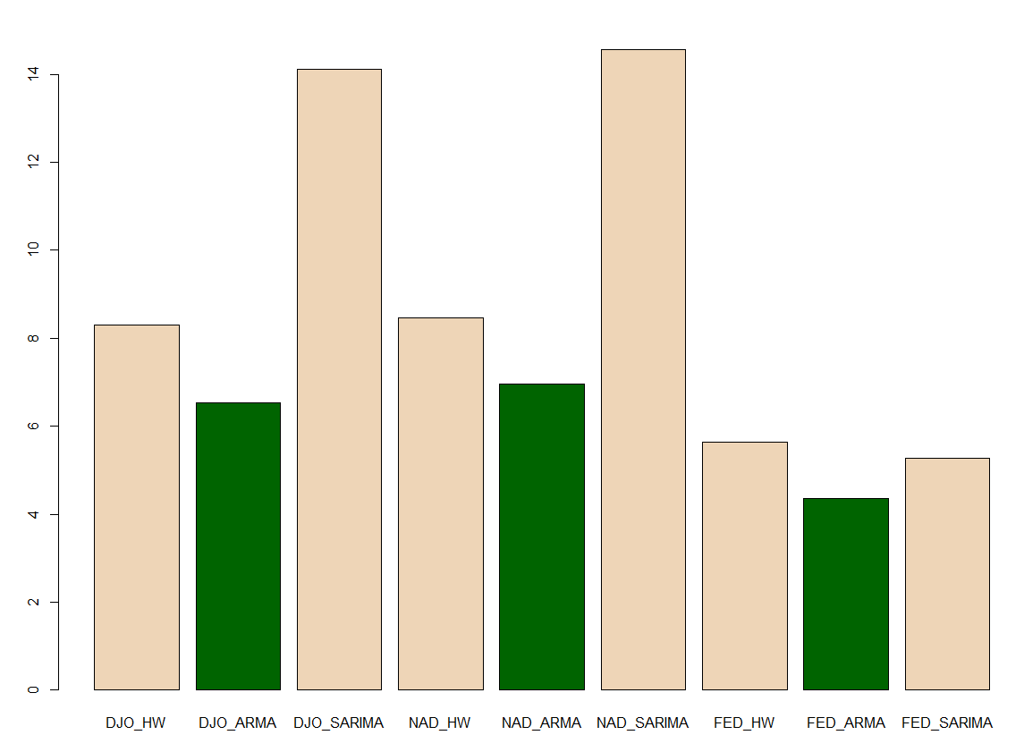
Results
We choose RMSE as the KPI to compare the forecasting models
Since tennis tournaments follow some type of elimination format, RMSE is more suitable than MAPE
RMSE of different models in predicting number of quarterly wins
We compare various models based on the KPI​
ARIMA models works best for our objective​
The following models work well in the top 3 player​s win forecast:
Djokovic – ARIMA order 2 1 1
Nadal – IMA order 0 1 1
Federer – IMA order 0 1 1
Djokovic's future performance depends on his performance two quarters ago other than his average performance
Nadal's and Federer's performances are only dependent on their average
Order 2,1,1
Order 0,1,1
Order 0,1,1

Slide 15
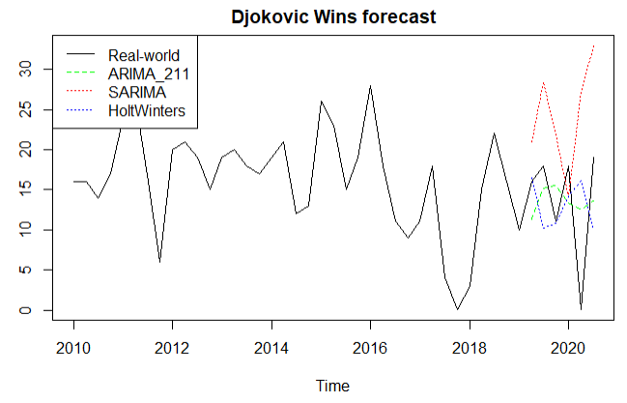
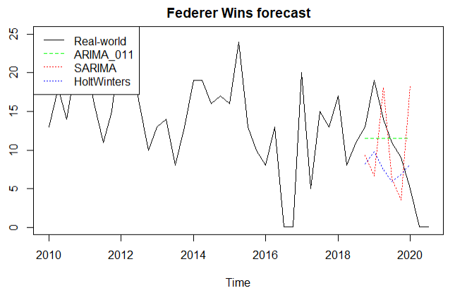
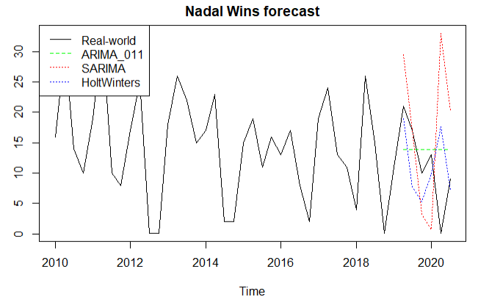
Results

Slide 16
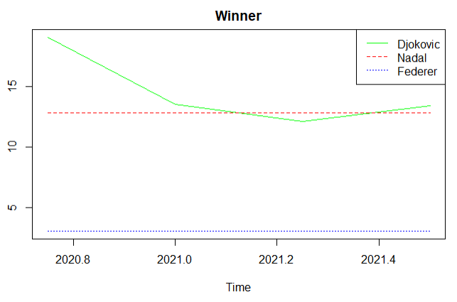
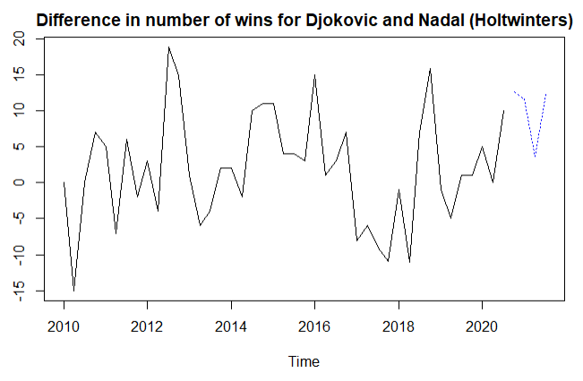
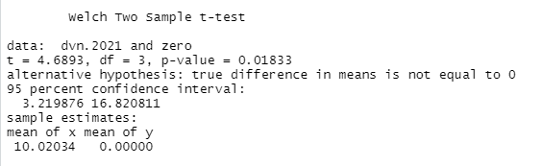
Results
Djokovic has higher probability to lead the ranks
At 95% C.I., Djokovic is expected to win 3 to 16 matches more than Nadal
Nadal can be very close but in 2nd position
We determined that Federer would remain in 3rd position

Slide 17

Conclusion
Most likely to have the best overall performance in 2021: Novak Djokovic
Most Likely to win the French Open 2021: Novak Djokovic
Most Likely to win the Wimbledon 2021: Novak Djokovic

